Slide 1
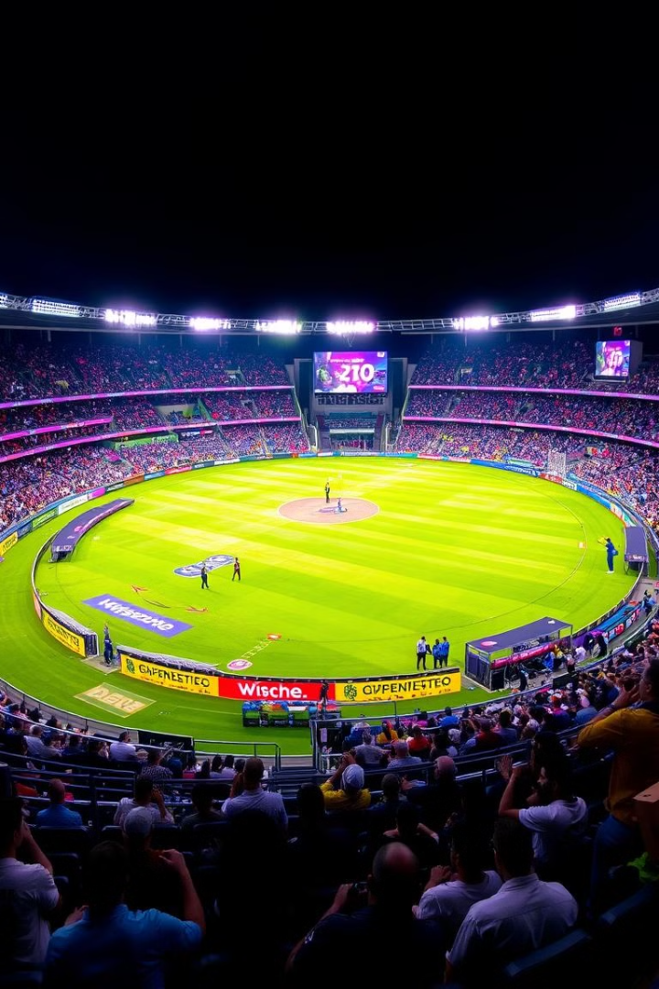
Cricket Match Simulator:
~Bringing the Game to Life!

Slide 2
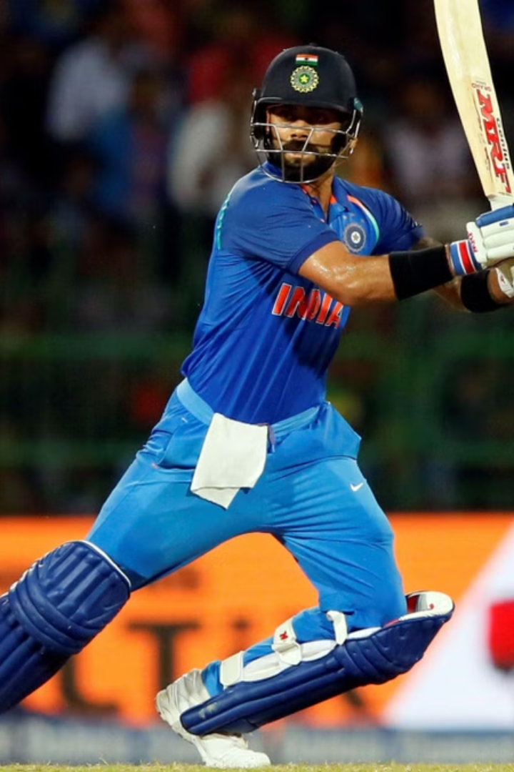
Bringing the Thrill of Cricket to Your Screen
Cricket is more than just a game—it’s an emotion! The Cricket Match Simulator brings the thrill of a live cricket match to your screen.
This Python-based project allows users to select match formats, witness the toss, track live scores, and view detailed player performances.
With a user-friendly interface and dynamic match progress, this project makes cricket simulation both exciting and interactive.

Slide 3
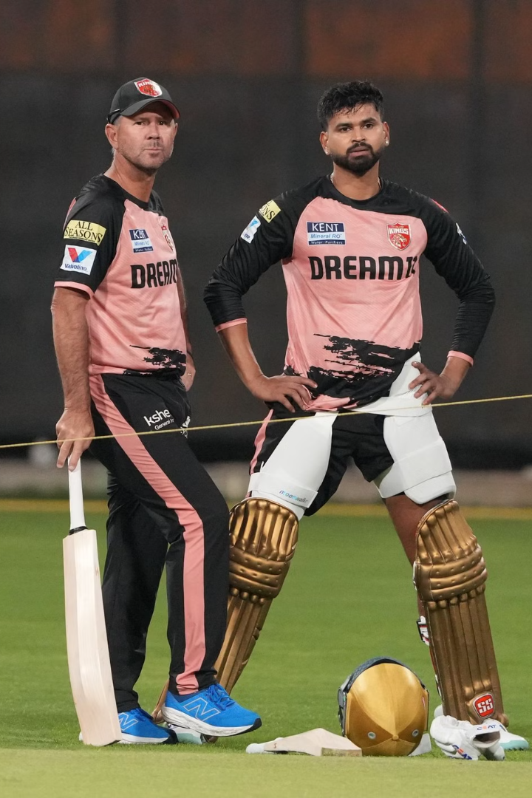
Key Features of the Cricket Match Simulator
Match Selection
Choose between ODI, T20, or Test Matches.
Toss Simulation
A random toss determines who bats or bowls first.
Playing XI Display
See the full squad, including the Captain and Wicket-Keeper.
Live Score Updates
Real-time updates: Follow the runs and wickets ball by ball.

Slide 4
CODE:
import random
import time matches = {
"1": {"teams": ["India", "Australia"], "type": "ODI", "overs": 50},
"2": {"teams": ["CSK", "MI"], "type": "T20", "overs": 20},
"3": {"teams": ["England", "Pakistan"], "type": "Test", "overs": 90},
} players = {
"India": ["Rohit Sharma", "Virat Kohli", "KL Rahul", "Shubman Gill", "Hardik Pandya",
"Ravindra Jadeja", "Axar Patel", "Kuldeep Yadav", "Jasprit Bumrah", "Mohammed Shami", "Mohammed Siraj"],
"Australia": ["David Warner", "Steve Smith", "Marnus Labuschagne", "Glenn Maxwell", "Pat Cummins",
"Cameron Green", "Mitchell Marsh", "Alex Carey", "Josh Hazlewood", "Nathan Lyon", "Mitchell Starc"],
"CSK": ["MS Dhoni", "Ruturaj Gaikwad", "Shivam Dube", "Moeen Ali", "Ravindra Jadeja",
"Ben Stokes", "Deepak Chahar", "Maheesh Theekshana", "Matheesha Pathirana", "Tushar Deshpande", "Devon Conway"],
"MI": ["Rohit Sharma", "Ishan Kishan", "Suryakumar Yadav", "Cameron Green", "Tilak Varma",
"Tim David", "Jofra Archer", "Piyush Chawla", "Jason Behrendorff", "Riley Meredith", "Jasprit Bumrah"],
"England": ["Joe Root", "Ben Stokes", "Jonny Bairstow", "Jos Buttler", "Harry Brook",
"Moeen Ali", "Chris Woakes", "Mark Wood", "Jofra Archer", "James Anderson", "Stuart Broad"],
"Pakistan": ["Babar Azam", "Mohammad Rizwan", "Fakhar Zaman", "Imam-ul-Haq", "Shadab Khan",
"Iftikhar Ahmed", "Mohammad Nawaz", "Haris Rauf", "Shaheen Afridi", "Hasan Ali", "Naseem Shah"],
}

Slide 5
team_roles = {
"India": {"captain": "Virat Kohli", "wicketkeeper": "KL Rahul"},
"Australia": {"captain": "Steve Smith", "wicketkeeper": "Alex Carey"},
"CSK": {"captain": "MS Dhoni", "wicketkeeper": "MS Dhoni"},
"MI": {"captain": "Rohit Sharma", "wicketkeeper": "Ishan Kishan"},
"England": {"captain": "Joe Root", "wicketkeeper": "Jos Buttler"},
"Pakistan": {"captain": "Babar Azam", "wicketkeeper": "Mohammad Rizwan"},
}
def sho1w_matches():
print("\nAvailable Matches:")
for key, match in matches.items():
print(f"{key}. {match['teams'][0]} vs {match['teams'][1]} - {match['type']} Match") def toss(team1, team2):
winner = random.choice([team1, team2])
decision = random.choice(["bat", "bowl"])
print(f"\nToss Winner: {winner}")
print(f"{winner} has chosen to {decision} first.")
return winner, decision def show_playing_xi(team):
print(f"\nPlaying XI for {team}:")
print(f" Captain: {team_roles[team]['captain']}")
print(f" Wicketkeeper: {team_roles[team]['wicketkeeper']}")
for player in players[team]:
if player not in (team_roles[team]['captain'], team_roles[team]['wicketkeeper']):
print(f" - {player}")

Slide 6
def simulate_innings(team, overs_limit, match_type, bowling_team,target=None):
"""
Simulates an innings over-by-over.
If 'target' is provided, the innings ends as soon as total_score reaches or exceeds it.
Returns:
total_score, wickets, batting_scorecard, over_analysis, bowling_scorecard
"""
print(f"\n🏏 {team} Batting Innings (Live) 🏏")
print(f"{team} is batting and {bowling_team} is bowling.")
total_score = 0
wickets = 0
batsman_index = 0
batting_scorecard = {}
current_batsman = players[team][batsman_index]
batting_scorecard[current_batsman] = {"Runs": 0, "Balls": 0, "Fours": 0, "Sixes": 0}
over_analysis = {} bowlers = players[bowling_team][-5:]
bowling_scorecard = {bowler: {"Overs": 0, "Runs": 0, "Wickets": 0, "Maidens": 0} for bowler in bowlers}

Slide 7
if match_type == "T20":
max_bowler_overs = 4
elif match_type == "ODI":
max_bowler_overs = 10
else:
max_bowler_overs = overs_limit # For Test, no strict limit
outcomes = ["0", "1", "2", "3", "4", "6", "W"]
outcome_weights = [0.25, 0.20, 0.10, 0.05, 0.20, 0.10, 0.10]
for over in range(1, overs_limit + 1):
if wickets >= 10 or (target is not None and total_score >= target):
break
available_bowlers = [b for b in bowlers if bowling_scorecard[b]["Overs"] < max_bowler_overs]
if available_bowlers:
bowler = random.choice(available_bowlers)
else:
bowler = random.choice(bowlers)
bowling_scorecard[bowler]["Overs"] += 1
runs_this_over = 0
maiden = True

Slide 8
for ball in range(6):
if wickets >= 10 or (target is not None and total_score >= target):
break outcome = random.choices(outcomes, weights=outcome_weights, k=1)[0]
batting_scorecard[current_batsman]["Balls"] += 1 if outcome == "W":
wickets += 1
bowling_scorecard[bowler]["Wickets"] += 1
print(f"Over {over}, Ball {ball+1}: {current_batsman} is OUT! Score: {total_score}/{wickets}")
maiden = False
batsman_index += 1
if batsman_index < len(players[team]):
current_batsman = players[team][batsman_index]
batting_scorecard[current_batsman] = {"Runs": 0, "Balls": 0, "Fours": 0, "Sixes": 0}
else:
break
else:
runs = int(outcome)
total_score += runs
runs_this_over += runs
batting_scorecard[current_batsman]["Runs"] += runs
if runs == 4:
batting_scorecard[current_batsman]["Fours"] += 1
elif runs == 6:
batting_scorecard[current_batsman]["Sixes"] += 1

Slide 9
if runs > 0:
maiden = False
print(f"Over {over}, Ball {ball+1}: {current_batsman} scores {runs} run(s) | Total: {total_score}/{wickets}")
time.sleep(0.2)
if target is not None and total_score >= target:
break
over_analysis[over] = runs_this_over
bowling_scorecard[bowler]["Runs"] += runs_this_over
if maiden:
bowling_scorecard[bowler]["Maidens"] += 1 print(f"End of Over {over}: {runs_this_over} runs | Score: {total_score}/{wickets}")
if target is not None and total_score >= target:
break print(f"\n{team} Innings Ended: {total_score}/{wickets} in {over} overs")
print("\nBatting Scorecard:")
print(f"{'Batsman':<20} {'Runs':<5} {'Balls':<5} {'4s':<3} {'6s':<3} {'SR':<6}")
for batsman, stats in batting_scorecard.items():
sr = round((stats["Runs"] / stats["Balls"]) * 100, 2) if stats["Balls"] > 0 else 0.0
print(f"{batsman:<20} {stats['Runs']:<5} {stats['Balls']:<5} {stats['Fours']:<3} {stats['Sixes']:<3} {sr:<6}" print("\nOver-to-Over Analysis:")

Slide 10
for ov, runs in over_analysis.items():
print(f"Over {ov}: {runs} runs") print("\nBowling Scorecard:")
print(f"{'Bowler':<20} {'Overs':<5} {'Runs':<5} {'Wkts':<5} {'Maidens':<7}")
for bowler, stats in bowling_scorecard.items():
print(f"{bowler:<20} {stats['Overs']:<5} {stats['Runs']:<5} {stats['Wickets']:<5} {stats['Maidens']:<7}")
return total_score, wickets, batting_scorecard, over_analysis, bowling_scorecard
def standard_match_simulation(team1, team2, match_type, overs_limit):
print(f"\n🏏 {team1} vs {team2} - {match_type} Match Start! 🏏")
toss_winner, decision = toss(team1, team2)
if decision == "bat":
first_batting = toss_winner
second_batting = team2 if toss_winner == team1 else team1
else:
first_batting = team2 if toss_winner == team1 else team1
second_batting = toss_winner show_playing_xi(team1)
show_playing_xi(team2) print(f"\n--- First Innings: {first_batting} batting ---")
first_score, first_wkts, bat1, over1, bowl1 = simulate_innings(first_batting, overs_limit, match_type, second_batting) print("\n--- Innings Break ---\n")
time.sleep(2)

Slide 11
target = first_score + 1
print(f"\n--- Second Innings: {second_batting} batting ---")
print(f"Target for {second_batting} is {target} runs.")
second_score, second_wkts, bat2, over2, bowl2 = simulate_innings(second_batting, overs_limit, match_type, first_batting, target=target)
print("\n🏆 MATCH RESULT 🏆")
if second_score >= target:
margin = 10 - second_wkts
print(f"🎉 {second_batting} wins by {margin} wickets!")
else:
margin = first_score - second_score
print(f"🎉 {first_batting} wins by {margin} runs!")
combined = {}
combined.update(bat1)
for batsman, stats in bat2.items():
if batsman in combined:
combined[batsman]["Runs"] += stats["Runs"]
else:
combined[batsman] = stats
potm = max(combined.items(), key=lambda x: x[1]["Runs"])
print(f"\n⭐ PLAYER OF THE MATCH: {potm[0]} with {potm[1]['Runs']} runs ⭐")

Slide 12
def test_match_simulation(team1, team2, overs_limit):
"""
Simulates a Test match with four innings.
Implements follow-on if first innings lead is 200+ runs.
Displays lead/trail after each innings.
""“
print(f"\n🏏 {team1} vs {team2} - Test Match Start! 🏏")
toss_winner, decision = toss(team1, team2)
if decision == "bat":
first_batting = toss_winner
second_batting = team2 if toss_winner == team1 else team1
else:
first_batting = team2 if toss_winner == team1 else team1
second_batting = toss_winner show_playing_xi(team1)
show_playing_xi(team2) print(f"\n--- 1st Innings: {first_batting} batting ---")
score1, wkts1, bat1, over1, bowl1 = simulate_innings(first_batting, overs_limit, "Test", second_batting) print(f"\n--- 1st Innings: {second_batting} batting ---")
score2, wkts2, bat2, over2, bowl2 = simulate_innings(second_batting, overs_limit, "Test", first_batting)
lead_after_1st = score1 - score2
if lead_after_1st > 0:
print(f"\nAfter 1st innings, {first_batting} leads by {lead_after_1st} runs.")
else:
print(f"\nAfter 1st innings, {second_batting} leads by {abs(lead_after_1st)} runs.")

Slide 13
follow_on = False
if lead_after_1st >= 200:
print(f"\n{second_batting} is asked to follow on!")
follow_on = True
if follow_on:
print(f"\n--- 2nd Innings (Follow-On): {second_batting} batting ---")
score3, wkts3, bat3, over3, bowl3 = simulate_innings(second_batting, overs_limit, "Test", first_batting)
new_lead = score1 - score3
print(f"\nAfter follow-on, {first_batting} leads by {new_lead} runs.")
print(f"\n--- 2nd Innings: {first_batting} batting ---")
target4 = new_lead + 1
print(f"Target for {first_batting} is {target4} runs.")
score4, wkts4, bat4, over4, bowl4 = simulate_innings(first_batting, overs_limit, "Test", second_batting, target=target4)
if score4 >= target4:
margin = 10 - wkts4
print(f"\n🎉 {first_batting} wins by {margin} wickets!")
else:
margin = target4 - score4
print(f"\n🎉 {second_batting} wins by {margin} runs!")
else:
print(f"\n--- 2nd Innings: {first_batting} batting ---")
score3, wkts3, bat3, over3, bowl3 = simulate_innings(first_batting, overs_limit, "Test", second_batting)
trail = score3 - score2

Slide 14
if trail > 0:
print(f"\nAfter 2nd innings, {second_batting} trails by {trail} runs.")
else:
print(f"\nAfter 2nd innings, {second_batting} leads by {abs(trail)} runs.")
print(f"\n--- 2nd Innings: {second_batting} batting ---")
target4 = score3 - score2 + 1
print(f"Target for {second_batting} is {target4} runs.")
score4, wkts4, bat4, over4, bowl4 = simulate_innings(second_batting, overs_limit, "Test", first_batting, target=target4)
if score4 >= target4:
margin = 10 - wkts4
print(f"\n🎉 {second_batting} wins by {margin} wickets!")
else:
margin = target4 - score4
print(f"\n🎉 {first_batting} wins by {margin} runs!")
combined = {}
for innings in [bat1, bat2]:
for player, stats in innings.items():
combined[player] = combined.get(player, 0) + stats["Runs"]
potm = max(combined.items(), key=lambda x: x[1])
print(f"\n⭐ PLAYER OF THE MATCH: {potm[0]} with {potm[1]} runs ⭐")

Slide 15
def match_simulation(team1, team2, match_type, overs_limit):
if match_type == "Test":
test_match_simulation(team1, team2, overs_limit)
else:
standard_match_simulation(team1, team2, match_type, overs_limit)
def main():
show_matches()
choice = input("\nEnter the match number you want to watch: ")
if choice in matches:
match = matches[choice]
team1, team2 = match["teams"]
match_type, overs_limit = match["type"], match["overs"]
if match_type == "ODI":
overs_limit = 50
elif match_type == "T20":
overs_limit = 20
elif match_type == "Test":
overs_limit = 90
match_simulation(team1, team2, match_type, overs_limit)
else:
print("\nInvalid selection. Please try again.") if __name__ == "__main__":
main()

Slide 16

Designed for Cricket Enthusiasts and Programmers
Full Cricket Experience
Randomization
Simulate a full cricket match with key programming concepts.
Mimic real cricket gameplay through randomization and match events.
Programming Concepts
Learn programming through simulated cricket gameplay.

Slide 17
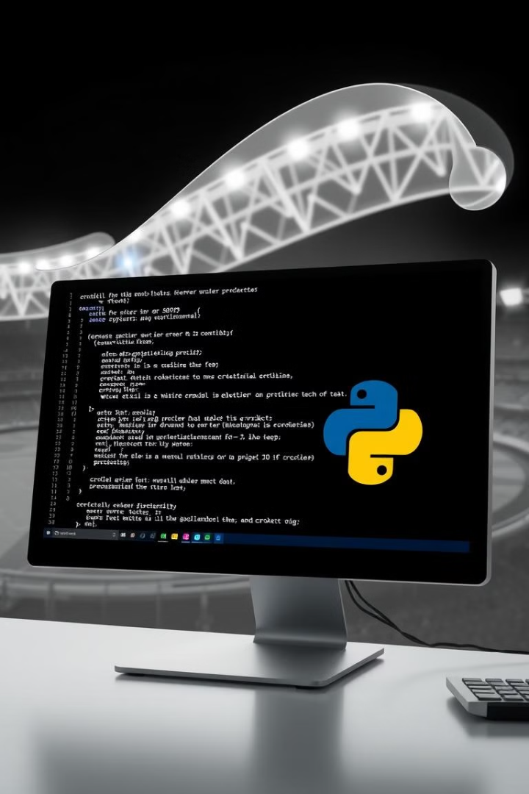
Understanding the Code Structure
Function Name
Purpose
show_matches()
Displays available match options.
toss(team1, team2)
Simulates the toss and decision-making.
show_playing_xi(team)
Displays the playing XI with captain and wicketkeeper.
simulate_innings(team, overs_limit, match_type, bowling_team, target=None)
Simulates an innings, including live score updates, wicket falls, and over analysis.
standard_match_simulation(team1, team2, match_type, overs_limit)
Simulates an ODI or T20 match with two innings.
test_match_simulation(team1, team2, overs_limit)
Simulates a full Test match with four innings, follow-on rules, and lead tracking.

Slide 18
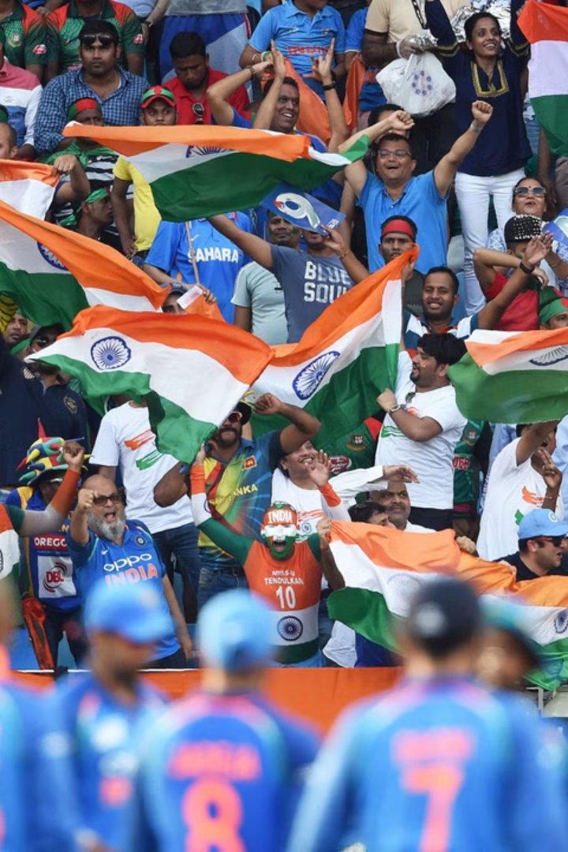



Conclusion: Seamless Integration
Our project showcases data-driven simulations and cricket logic for a realistic match experience. Understand structured programming principles while enjoying cricket.
Data Simulations
Engaging and realistic experience
Cricket Logic
Enhances understanding of cricket
Structured Programming
Demonstrates key principles

Slide 19


TEAM:
G.POORNA NAGA SAI - AP23110010321
G.SRI TEJA - AP23110010265
B. SIDDARTHA - AP23110010314
M. LEELA VARDHAN - AP23110010303

